Slide 1
Integrated practice ④
Receiving system of luggage delivering to the home
Requirement specification
Notes:
Copyright Act Brain Co.

Slide 2
1Outline
We develop the receiving system of delivering luggage to the home for the apartment house. (Thereafter, it is described as "Receiving system")
When the receiver is an absence, the courier service puts the delivered luggage in the luggage box of the receiving system (Thereafter, it is described as "Box").
The receiving system hands over luggage by informing the receiver of arrival of goods.
Notes:
Copyright Act Brain Co.

Slide 3
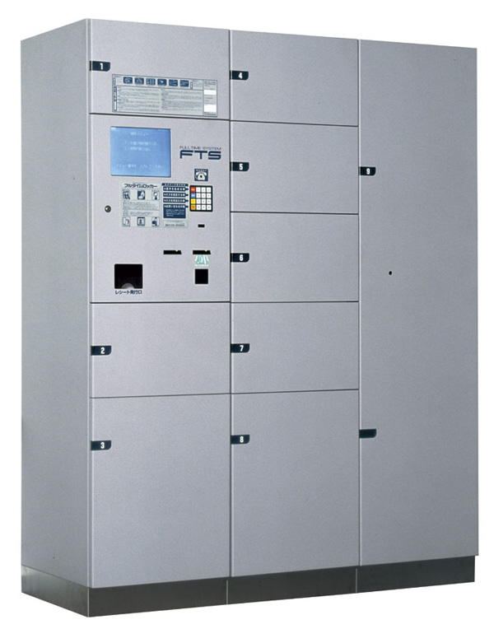
1. Outline
Image of receiving system
Notes:
Copyright Act Brain Co.

Slide 4
2. Structure of receiving system
The structure of the receiving system is shown below.
(A red line with the arrow shows the flow of data. )
Luggage part 1
Luggage part 2
Luggage part 3
Box
1
Box
2
Box
1
Box
2
Box
1
Box
2
Luggage I/F
TCP communication
Control part
LCD
Operation board
Arrival of
goods
10 Key
Printer
Receiving
Notes:
Copyright Act Brain Co.
The details of the system is described as follows.

Slide 5
2. Structure of the receiving system
The receiving system is composed of control part, luggage I/F part, and 3 pieces of luggage part.
In the control part, there are a printer, LCD, and an operating panel. The operating panel has the key of arrival of goods, the receiving key, and ten keys.
Make the program with a console for LCD and the operating panel and a console for the printer.
Luggage I/F part is located between the control part and luggage part, and communicates with the control part using TCP.
Notes:
Copyright Act Brain Co.

Slide 6
2. Structure of receiving system
The number of 1-3 is given to three pieces of luggage (This number is assumed to be X). In each luggage, there are two box 1 and 2 that can lock it (This number is assumed to be Y). The box is locked usually. Unlocking and the lock can be done by instructing the control part. Box number XY is given to each box respectively. (The box number of box 1 in luggage part 2 becomes 21. )
In the program, make luggage 1, 2, and 3 respectively using a console.
Notes:
Copyright Act Brain Co.

Slide 7
3. Outline of operation of receiving system
（１）Arrival of goods of luggage
When the delivery trader pushes the key of arrival of goods, and the box number is input, the control part transmits the unlocking instruction to the specified box.
After opening the box and putting luggage, the delivery trader closes the box. And, the delivery trader inputs the room number of the receiver and the courier service ID that has been decided beforehand.
The control part transmits the lock instruction of the box that luggage entered to the luggage part. When the lock instruction is received, luggage part locks the box that luggage entered.
Notes:
Copyright Act Brain Co.

Slide 8
3. Outline of operation of receiving system
（１）Arrival of goods of luggage
The printer issues the slip that describes the following content.
・ Date of arrival of goods
  Courier service name
  Room number
  Box number
  Number of arrival of goods that doesn't overlap that receiving system decided
※ The status of the receiving system returns to the initial status before operation of arrival of goods is done when the box is closed without putting luggage after the delivery trader opens at ②.
Notes:
Copyright Act Brain Co.
・Please decide freely the specification of the number of arrival of goods that doesn't overlap that the receiving system decided.

Slide 9
3. Outline of operation of receiving system
（２）Taking out of luggage
When the receiver pushes the receipt key, and the room number is input, the date of arrival of goods and the name of courier service of all the luggage to the room are displayed in LCD.
When the receiver inputs the number of arrival of goods notified when arriving, the control part transmits the unlocking instruction to the box number of the corresponding luggage. And, the control part displays the box number in LCD.
When the unlocking instruction is received, luggage part unlocks the box of the correspondence. When luggage is taken out of the box, the control part transmits the lock instruction to the box. And, the control part displays taking out luggage in LCD.
Notes:
Copyright Act Brain Co.

Slide 10
4. Functional overview of each part
（１）Control part
The control part controls the entire receiving system.
The control part has the communication function with luggage part.
（２）Luggage part
In the box, there is a sensor that detects the existence of luggage. When the box is closed, luggage part informs of the box number and the existence of luggage to the control part.
Luggage part executes lock and unlock of the specified box by the instruction of the control part.
Notes:
Copyright Act Brain Co.

Slide 11
5. Communication between control part and luggage part
（１）Outline of communication data
The size of data is always constant.
The control part can set the following content to the position of data.
① Box number
  Lock instruction or unlocking instruction of box
  ・Luggage part can set the following content to the position of data.
  Box number
  Stock notification of luggage to box, or delivery notification from the box.
Notes:
Copyright Act Brain Co.

Slide 12
5. Communication between control part and luggage part
（２）Operation of control part
The control part transmits data at a constant cycle. At this time, the control part sets the content of the data of luggage to the null.
The control part sets null data when there is no data transmitted from the control part.
The control part receives the data that returns via each luggage part.
Notes:
Copyright Act Brain Co.

Slide 13
5. Communication between control part and luggage part
（３）Operation of luggage part
When the address of the received data is my box, luggage part takes the content.
When the address of the received data is not my box, luggage part transmits the packet by the following method.
①Luggage part transmits the received data as it is when there
is no transmitted content.
  ②When there is a transmitted content, luggage part sets the content to the position of the received data, and transmits data. However, when data has already been set to the position, luggage part transmits the received data as it is.
  The transmitted content is set to the next data and transmitted
Notes:
Copyright Act Brain Co.

